Slide 1

EPA Fuel Economy
Annual Fuel Cost and Tailpipe CO2
Notes:
Hello, my name is Domingo, and today I will be going over some EPA Fuel Economy observations primarily focused on Annual Fuel Cost and Tailpipe CO2 Emissions.

Slide 2
Introduction
Downward trending Average Annual Fuel Cost over recent years
Downward trending Average Tailpipe CO2 Emissions
Notes:
Why Fuel cost and CO2 emissions?
Well when looking over the data provided and putting together some line graphs we can see downward trends in both Fuel and CO2 in recent years.
Going forward the primary question I'm looking to answer is “What can we do to keep this trend going down”

Slide 3
Hypothesis
H1 – There is no difference in Annual Fuel Cost and Tailpipe CO2 between Compact cars and Midsize Cars
H2 – There is no difference in Annual Fuel Cost and Tailpipe CO2 between Regular Fuel and Premium Fuel
Notes:
Looking deeper into the data, 2 hypothesis to check are the comparison between Compact cars and Midsize Cars, then between using Regular Fuel vs Premium Fuel

Slide 4
Data Set
38,000+ vehicles
Year, Make, Model
Fuel Type
Annual Fuel Cost
Tailpipe CO2
Notes:
In our data set we are given over 38000 difference vehicles, the year make and model of each vehicle, as well as the Fuel type, Annual fuel cost, and Tailpipe CO2 emissions measured in Grams per Mile
Specifically looking at the data we will be testing. We find 5500 Compact cars and 4400 Midsize cars.
Separately looking at 25000 vehicles using Regular fuel and 10000 using Premium

Slide 5
Methods
Pivot Tables
T-test
Analysis Toolpak
Excel functions/formulas
Notes:
The methods used to get final results started with Pivot tables to sort and filter data. T-test we run with the help of the Analysis Toolpak addon in excel as well as running some Descriptive Statistics to get more in depth answers. Then using Excel Functions and Formulas we were able to produce graphs and a finalized dashboard for further comparison.

Slide 6
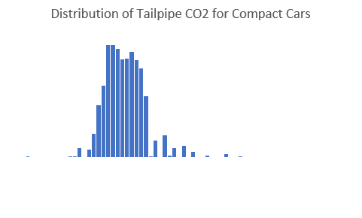
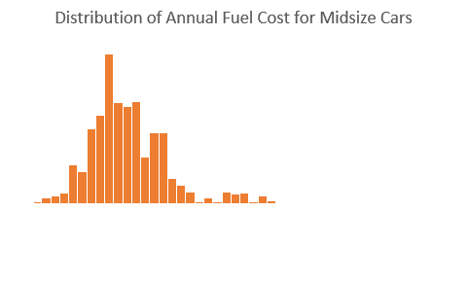
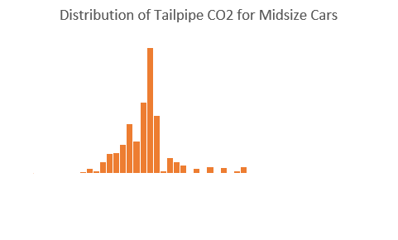
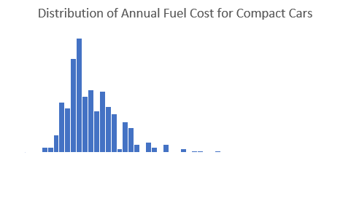
Hypothesis 1 - Compact Vs Midsize Vehicles Distribution
Notes:
Looking at the distribution of data provided, we can see Compact car Annual Fuel Cost peaks around 1300-1500 and Midsize cars peak around 1500-1700.
Then when comparing distributions of Tailpipe CO2, we see that the majority of compact cars are around and under 450 Grams per Mile. Where Midsize cars peak around the 500 grams per mile mark.

Slide 7
Hypothesis 1 - Compact Vs Midsize Vehicles Averages
Notes:
Looking at graphs of the Average Annual Fuel Cost and Average Tailpipe CO2, we can see quite a difference between Compact cars and Midsize Cars. On average Midsize cars with cost between $168 and $212 yearly for fuel, and produce between 37 and 46 grams per mile of CO2.

Slide 8
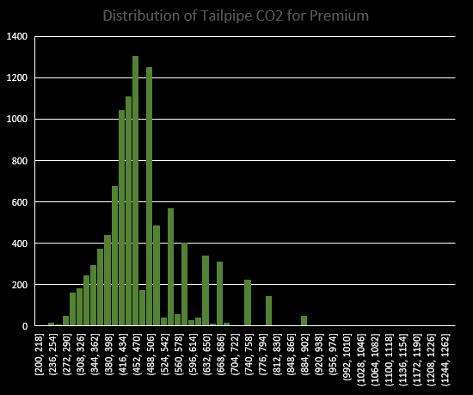
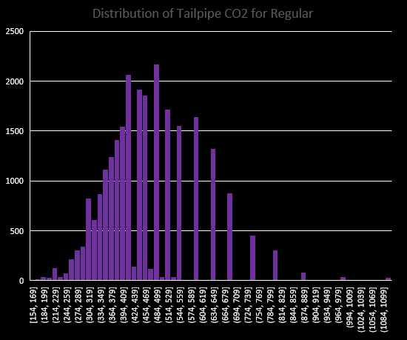
Hypothesis 2 - Regular Fuel Vs Premium Fuel Distribution
Notes:
Moving into Hypothesis 2, data did not show a significant difference in Annual Fuel Cost so we will be focusing on Tailpipe CO2 emissions. At first glance it looks Regular fuel is more evenly distributed while Premium fuel has a steeper peak. However both peaks sit around 470 grams per mile of Tailpipe CO2.

Slide 9
Hypothesis 2 Regular Fuel Vs Premium Fuel Averages
Notes:
With enough evidence to prove significant difference, we see between 8 and 13 grams per mile of CO2 emission more in premium fuel.

Slide 10
Recommendations
Less Annual Fuel Cost driving Compact cars
Reduce Tailpipe CO2 emissions driving Compact cars
Reduce Tailpipe CO2 emissions using Regular Fuel
Notes:
Back to our question “What can we do to keep this trend going down” our test show that Compact cars have a lower Average Annual Fuel Cost and lower Average Tailpipe CO2 emissions. On top of that is we use regular fuel we can reduce CO2 emissions even more.

Slide 11
Dashboard
Notes:
I have built a dashboard that lets a user break down these graphs and test even further. Specifying the make of vehicles comparing them to another make and producing a graph to show difference in Annual Fuel Cost and CO2 emissions.

Slide 12

THANK YOU

